Slide 2
container communication with VPP
Keith Burns
BRKSDN-2119

Slide 3
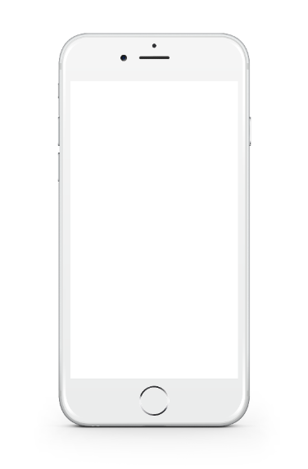

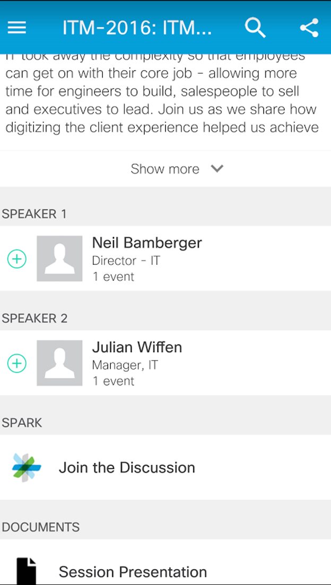
Cisco Spark
Questions? Use Cisco Spark to chat with the speaker after the session
How
Find this session in the Cisco Live Mobile App
Click “Join the Discussion”
Install Spark or go directly to the space
Enter messages/questions in the space
Cisco Spark spaces will be available until July 3, 2017.
cs.co/ciscolivebot#BRKSDN-2119
© 2017 Cisco and/or its affiliates. All rights reserved. Cisco Public

Slide 4


What the industry had to invent
Resource Allocation
Resource Usage
Data Access Control
POLICY
ENGINE
Network Intelligence, Guidance
APPLICATIONS
& PaaS
ANALYTICS
Statistics, States, Objects and Events
REACTIVE, COMPUTE NETWORK, STORAGE AND SECURITY – MODULAR, COMPOSABLE ARCHITECTURES
Workflow
SERVICE ORCHESTRATION
AND CONTROL
NETWORK
Programmability

Slide 5




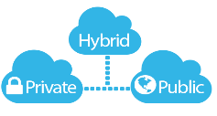






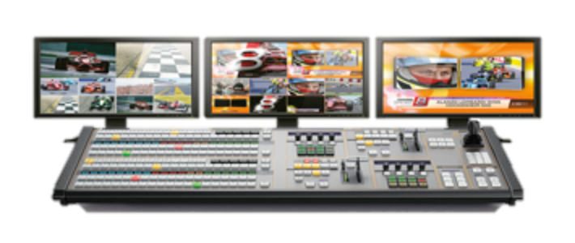
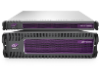

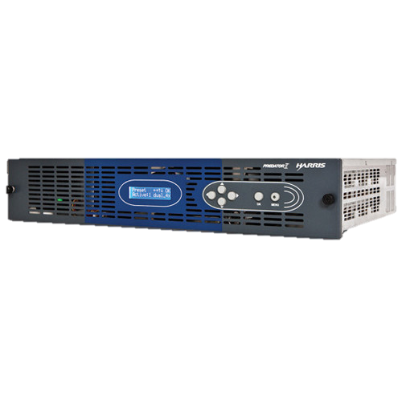
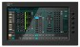
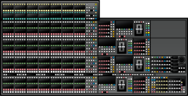
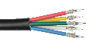
Infrastructure Continuously Evolving…
2018
WHAT’S NEXT …
2016
CONTAINERS
2012
CLOUD
Virtual Media Functions
Virtual Media Functions
2008
VIRTUAL MACHINES
Virtual Media Functions
Virtual Media Functions
BARE METAL
…
Physical Media Functions
Cloud
Industry
SDI Cables
Media
Industry
GAP

Slide 6
Containers and microservices

Slide 7
Microservice decomposition
Compute
App VM
App VM
device

Slide 8
Microservice decomposition
Application
Application
component
component
component
component
component
component

Slide 9
Microservice decomposition
container
container
container
container
container
container

Slide 10
Microservice decomposition
What I said I did
What management heard
but....

Slide 11
Microservice decomposition
overlays, underlays, tunnels, extending L2 etc etc

Slide 12
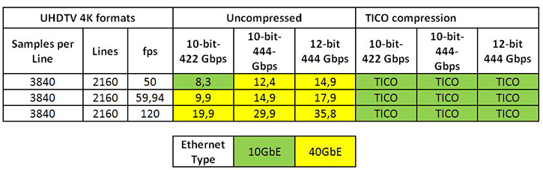
Chunky case - video
Uncompressed data rate = color depths * vertical resolution * horizontal resolution * refresh frequency
August 27, 2015, TVTechnology

Slide 13
“Encoding in multiple formats in parallel including raw uncompressed per camera”
BBC: IP Studio project
… “Destination-timed switching is probably the simplest way to switch video on commodity Ethernet switches, but it generally requires twice the bandwidth of a single video signal to be reserved.”
Thomas Edwards of Fox, June 10, 2015, TVTechnology.com

Slide 14
Death by a thousand cuts case - distributed
“Compute is going to everywhere, …
... compute will be distributed from end points and in layers of networks before data is even shipped back into the datacenter...
..there could be as much processing outside the “server” and the “datacenter” as inside of it. These terms could become somewhat meaningless.”
- Peak X86, The Next Platform, Sep 15, 2016

Slide 15
Implications of reality...
100Gbps NICs are reality
Use cases exist today for 100Gbps per workload
3D XPoint and Memristor technology is reality
Machine learning algorithms being held back by lack of real-time streaming instrumentation

Slide 16

Kubernetes 1.6 - 5,000 node 150,000 pod clusters
k8s
http://blog.kubernetes.io/2017/03/scalability-updates-in-kubernetes-1.6.html

Slide 17
Implications of containers
Lots of individually addressed elements to manage
Lots of sessions to scale
Predictable performance under load
Instrumentation - Do you know who is talking to who? How much?

Slide 18
fd.io intro: why, what, how

Slide 19



Vector Packet Processor - VPP
Bare Metal/VM/Container
Packet Processing Platform:
High performance
Linux User space
Run’s on commodity CPUs:
Shipping at volume in server & embedded products since 2004.
Dataplane Management Agent
Packet Processing
Network IO

Slide 20
VPP Architecture: Packet Processing
Packet
…
0
1
2
3
n
Vector of n packets
dpdk-input
vhost-user-input
…
af-packet-input
Packet Processing
Graph
Input Graph Node
ethernet-input
Graph Node
ip6-input
ip4-input
mpls-input
…
arp-input
ip6-lookup
ip4-lookup
ip6-rewrite
ip6-local
ip4-local
ip4-rewrite

Slide 21
VPP Architecture: Programmability
Architecture
Example: go-agent
Contiv
Control Plane Protocol
Request Message
900k request/s
Request Message
Linux Hosts
Linux Hosts
Shared Memory
Shared Memory
Agent
…
VPP
go-vpp
Agent
…
VPP
Request Queue
Request Queue
…
…
Response Queue
Response Queue
Can use GO/C/Java/Python/or Lua
Language bindings
Async Response Message
Async Response Message

Slide 22
What is networking?

Slide 23
As an developer, this is networking....

Slide 24
Container networking
PID 1234
PID 4321
glibc
send()
recv()
kernel
FIFO
FIFO
TCP
TCP
IP (routing)
IP (routing)
device
device

Slide 25
Container networking with VPP
PID 1234
VPP
PID 4321
ACL, SR, VXLAN-GPE
ip(4|6)-rewrite
ip(4|6)-input
ethernet-input
send()
recv()
FIFO
FIFO
af_packet
dpdk
af_packet
TCP
TCP
IP (routing)
FIFO
dpdk
FIFO
IP (routing)
device
device
device
device
device

Slide 26
Why not this?
PID 1234
PID 4321
send()
recv()
VPP
FIFO
FIFO
session
transport
IP
DPDK

Slide 27


Slide 28
Demo with Docker
Demo (2min YouTube)

Slide 29


Slide 30
How does it work?

Slide 31
“day in the life of host-stack”
app
vppcom_session_create( vrf, proto)
vppcom_session_bind( fd, vppcom_endpt)
vppcom
VPP
session state
transport listener
vppcom
app

Slide 32
“day in the life of host-stack”
app
vppcom_session_listen()
vppcom_session_accept()
vppcom
VPP
session state
transport listener
vppcom
app

Slide 33
“day in the life of host-stack”
app
vppcom
VPP
session state
transport listener
vppcom
app
vppcom_session_connect(fd, vppcom_endpt)

Slide 34
“day in the life of host-stack”
app
vppcom_session_read()
vppcom_session_write()
vppcom
VPP
FIFO
FIFO
vppcom
app
vppcom_session_write()
vppcom_session_read()

Slide 35
“day in the life of host-stack”
app
socket(), bind(), listen(), accept(), read(), write(), close()
LD_PRELOAD
kernel
vppcom
vppcom_session_ ... ()
VPP
vppcom_session_ ... ()
vppcom
LD_PRELOAD
kernel
app
socket(), connect(), read(), write(), close()

Slide 36

What do we need for inter-host?
compute
compute
😀
VPP
FIFO
FIFO
😡

Slide 37
What do we need for inter-host?
compute
compute
😀
😀
VPP
VPP
FIFO
FIFO
FIFO
FIFO
session
session
transport
transport
IP
IP
DPDK
DPDK

Slide 38
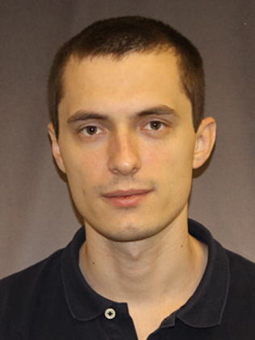
VPP host-stack
Dave Barach
Cisco Fellow
Inventor of VPP
PTL fd.io VPP project
Florin Coras
Software Engineer
MR LISP
.. and Mr TCP
Target:
10M concurrent connections
100K Connections Per Second
State machine merged in VPP 17.04
Currently in development:
Modular Congestion management
Scale and Performance tuning

Slide 39
What else can you do with a host-stack graph node?
VPP
SSL termination
HTTP Load Balancing
HTTP Proxy
DNS/DHCP
API AuthZ / gateway
DPI
session
transport
IP
DPDK

Slide 40
Benefits

Slide 41
Service Discovery
PID 4321
PID 1234
socket()
bind()
listen()
accept()
VPP
connection
manager
sockaddr_in(”stream”, “80”)

Slide 42

Service Discovery
PID 4321
PID 1234
socket()
bind()
listen()
container agent
match: (”stream”, “80”)
action: allow | chain
accept()
VPP
connection
manager
sockaddr_in(”stream”, “80”)

Slide 43
Service Discovery
PID 4321
PID 1234
socket()
sockaddr_in(”stream”, “80”)
bind()
listen()
container agent
match: (”stream”, “80”)
action: allow | chain
accept()
sockaddr_in(”stream”, “80”)
VPP
connection
manager
sockaddr_in(”stream”, “80”)

Slide 44

Service Discovery
Where is sockaddr_in(”stream”, “80”) ?
PID 4321
PID 1234
service discovery
socket()
connect()
sockaddr_in(”stream”, “80”)
bind()
listen()
container agent
match: (”stream”, “80”)
action: allow | chain
accept()
sockaddr_in(”stream”, “80”)
VPP
connection
manager
sockaddr_in(”stream”, “80”)

Slide 45
Intelligent Policy and Security
SHA: …fda7 ==
PID 1234
Image SHA ...fda7
match: (”stream”, “80”)
action: allow | chain
socket()
bind()
listen()
accept()

Slide 46
Intelligent Policy and Security
SHA: …fda7 ==
PID 1234
Image SHA ...fda7
match: (”stream”, “80”)
action: allow | chain
socket()
match: (”stream”, “80”)
action: allow | chain
bind()
listen()
container agent
match: (”stream”, “80”)
action: allow | chain
sockaddr_in(”stream”, “80”)
accept()
VPP
sockaddr_in(”stream”, “80”)
connection
manager

Slide 47
Intelligent Policy and Security
SHA: …fda7 ==
PID 1234
Image SHA ...fda7
match: (”stream”, “80”)
action: allow | chain
service discovery
socket()
match: (”stream”, “80”)
action: allow | chain
bind()
sockaddr_in(”stream”, “80”)
listen()
container agent
match: (”stream”, “80”)
action: allow | chain
sockaddr_in(”stream”, “80”)
accept()
VPP
sockaddr_in(”stream”, “80”)
connection
manager

Slide 48
Benefits – service ready ?
tThis is when a service is ready….
app
API()
kernel
… not this.
device

Slide 49
Benefits – FIFO quiesce
kubectl rolling-update …
PID 1234
send()
VPP
FIFO
FIFO
FIFO
PID 1234: “Is allowed ZERO FIFOs - starting now”
container agent

Slide 50
Rate limit # connections – not Gbps
PID 1234
VPP
FIFO
send()
FIFO
FIFO
FIFO
container agent
”You need to stop…”

Slide 51
A new Service Chain?
VNF
VNF
VNF
packet
packet
packet
packet

Slide 52
A new Service Chain?
VNF
VNF
VNF
packet
packet
VPP
FIFO
FIFO
packet
packet

Slide 53
why not this?
VNF
VNF
VNF
packet
packet
VPP
FIFO
packet

Slide 54
why not this?
VNF
VNF
VNF
packet
packet
“Hey BLUE, message for you!”
VPP
FIFO
packet

Slide 55
why not this?
VNF
VNF
VNF
packet
packet
“GREEN! Here’s a pointer to something I’ve seen!”
VPP
FIFO
packet

Slide 56
memif: but wait there’s more ...

Slide 57
memif – Motivation
create packet based shared memory interface for user-mode application
be container friendly (no privileged containers needed)
Support both polling and interrupt mode operation
Interrupts simulated with linux eventfd infrastructure
Support for interrupt masking in polling mode
Support vpp-to-vpp, vpp-to-3rd-party and 3rd-party-to-3rd-party operation
support for multiple queues (incl. asymmetric configurations)
Jumbo frames support (chained buffers)
Take security seriously
Multiple operation mode: ethernet, ip, punt/inject
3rd-party library - allows easy creation of applications which communicate over memif (in development)

Slide 58
memif – Security
Point-to-point Master/Slave concept:
Master - Never exposes memory to slave
Slave - Responsible for allocation and sharing memory region(s) to Master
Slave can decide if it will expose internal buffers to master or copy data into separate shared memory buffer
Shared memory data structures (rings, descriptors) are pointer-free
Interfaces are always point-to-point, between master-slave pair
Shared memory is initialized on connect and freed on disconnect
Interface is uniquely identified by unix socket filename and interface id pair
There is optional shared secret support per interface
optionally master can get PID, UID, GID for each connection to socket listener

Slide 59
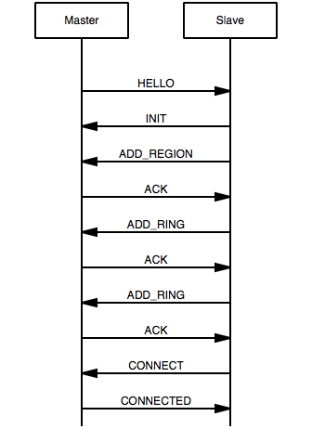
memif – Control Channel
Implemented as Unix Socket connection (AF_UNIX)
Master is socket listener (allows multiple connections on single listener)
Slave connects to socket
Communication is done with fixed size messages (128 bytes):
HELLO (m2s): announce info about Master
INIT (s2m): starts interface initialization
ADD_REGION (s2m): shares memory region with master (FD passed in ancillary data)
ADD_RING (s2m): shares ring information with master (size, offset in mem region, interrupt eventfd)
CONNECT (s2m): request interface state to be changed to connected
CONNECTED (m2s): notify slave that interface is connected
DISCONNECT (m2s, s2m): disconnect interface
ACK (m2s, s2m): Acknowledge

Slide 60
Control Plane – Contiv integration

Slide 61
Container Control Plane Stack
Orchestration
Kubernetes
SFC Controller
Contiv Netmaster
…
VNF
VNF
VNF
Analytics/PNDA
VPP vSwitch
Data Plane Acceleration
…
Specs
Install
Automated Tests

Slide 62
ODPM: VNF Data Plane Orchestration - Contiv
Nikos Bregiannis
Software engineer
fd.io vpp container control plane lead
REST
SFC Controller
Policy (tbd.)
Kubernetes
Contiv Netmaster
etcd
Server
Server
Kube Proxy
CNI
Contiv
Kube Proxy
CNI
Contiv
Driver
Driver
VNF
VNF
VNF
VNF
VNF
VNF
Agent
Agent
Agent
Agent
FIFO
MEMIF
MEMIF
FIFO
MEMIF
MEMIF
VPP vSwitch
VPP vSwitch
Agent
Agent

Slide 63


Slide 64
To Learn More...
http://fd.io – fd.io website
http://gerrit.fd.io – download the code!
https://wiki.fd.io/view/VPP – vpp core project wiki
Fd.io YouTube Channel – many hours’ worth of high-quality video
Tutorials, code walkthroughs, architecture, continuous integration and test.
http://lists.fd.io – mailing lists
https://contiv.github.io/ - Contiv
Visit us at DevNet Zone!

Slide 66
Continue Your Education
Demos in the Cisco campus
Walk-in Self-Paced Labs
Lunch & Learn
Meet the Engineer 1:1 meetings
Related sessions

